Slide 1
NDOP Health Outreach Program
Grace Gardens Hospital Ndop
Global Bridge Pharmaceuticals

Slide 2
OUTLINE
Background of Program
  Global Bridge Pharmaceuticals (GBP)
  Grace Gardens Hospital Ndop (GGHN)
The Challenges
Functionality of Program
Privacy

Slide 3

WHO IS GLOBAL BRIDGE PHARMACEUTICALS?
Pharmaceutical company
  U.S Licensed
  FDA registered
Pharmaceutical Services including
  Distribution
  Manufacturing
  Medication Outreach
  Consultation Services
Charlotte, NC USA

Slide 4
WHERE WE’VE BEEN!
Performing services since 2014
Collaborating with communities in several African countries – Cameroon, DRC, Ghana, Ivory Coast, Kenya, Nigeria and Uganda
Over 5,000 patients, hospitals and companies have been served in Africa
Partnering with individuals, groups, companies and hospitals, with our most recent collaboration with Grace Gardens Hospital Ndop

Slide 5

WHO IS GRACE GARDENS HOSPITAL NDOP?
Hospital setting
Catering to the needs of the people in the Ngoketunjia Division of the NWP, providing
  Medical care
  Prevention and holistic healthcare
  Education and awareness
Located in Ndop, NW province, Cameroon
Faith Gardens Medical Foundation, Dallas, TX, USA
  Medical missions to Cameroon since 2013

Slide 6
THE CHALLENGES

Slide 7
STATISTICS FROM WHO
Over three quarters of CVD deaths take place in low- and middle-income countries (LMIC)
Out of the 17 million premature deaths (under the age of 70) due to NCD in 2015, 82% are in LMIC and 37% are caused by CVDs.
WHO projects that by 2030, NCD will be the leading cause of death in LMICs, even though communicable diseases continue to remain high
WHO estimates approximately 40% of the drug market in Africa is made of counterfeit products, this could be the difference between life and death.
CVD- cardiovascular disease NCDs-non communicable diseases WHO- World Health Organization

Slide 8
Recognize these Disease States/drugs?
Category | Drugs
Hypertension | Amlodipine, Lisinopril, HCTZ, Metoprolol, carvedilol, hydralazine, Furosemide
Diabetes | Metformin, Glyburide. Glipizide, Glimepiride, Pioglitazone
Hypercholesterolemia | Atorvastatin, Rosuvastatin, Pravastatin, Simvastatin
Cancer | Casodex (Bicalutamide), Arimidex (Anastrazole), bleomycin
Respiratory | Albuterol inhaler/nebulizer, Advair, Spiriva, prednisone, Singulair
Anticoagulants | Warfarin, Eliquis, Clopidogrel, Xarelto
Pain Management (Arthritis, back, migraine) | Diclofenac gel, Lidocaine patches, Acetaminophen, Ibuprofen, Naproxen, Triptans,

Slide 9
THE SITUATION
These chronic conditions require routine medications/checkups, however,
  Lack of medical resources
    quality and affordable for all
  Routine interruptions in drug supplies
    market monopoly
  Counterfeit medicines
    lack of regulatory bodies
  Pose a huge problem to receiving quality affordable healthcare

Slide 10
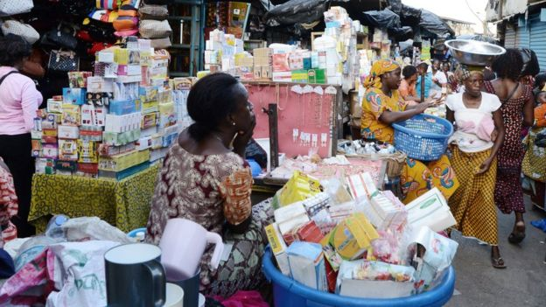
https://www.bbc.com/news/business-37470667

Slide 11
https://www.who.int/bulletin/volumes/88/4/10-020410/en/

Slide 12
GOALS OF THE PROGRAM
Access
  To provide access to top quality medications, medical devices and medical services from the U.S to our families and friends back at home. No middleman and No counterfeit
Cost
  Very affordable and paid for by individuals, third parties or NGOs
Peace of mind
  Knowing that your families and friends back at home are getting the right medical attention at the right time, improving drug adherence thus better quality of life
NGO – Non-Governmental Organization

Slide 13
DISEASE STATE OUTCOMES
Diabetes
  Poor circulation
    Nerve damage – amputation
    Kidney damage – dialysis, kidney transplant
    Retinopathy
Hypertension
  Heart failure
Cholesterol
  Blockage of arteries with plaque
    MI
Drug resistant strains
  Malaria
  TB

Slide 14
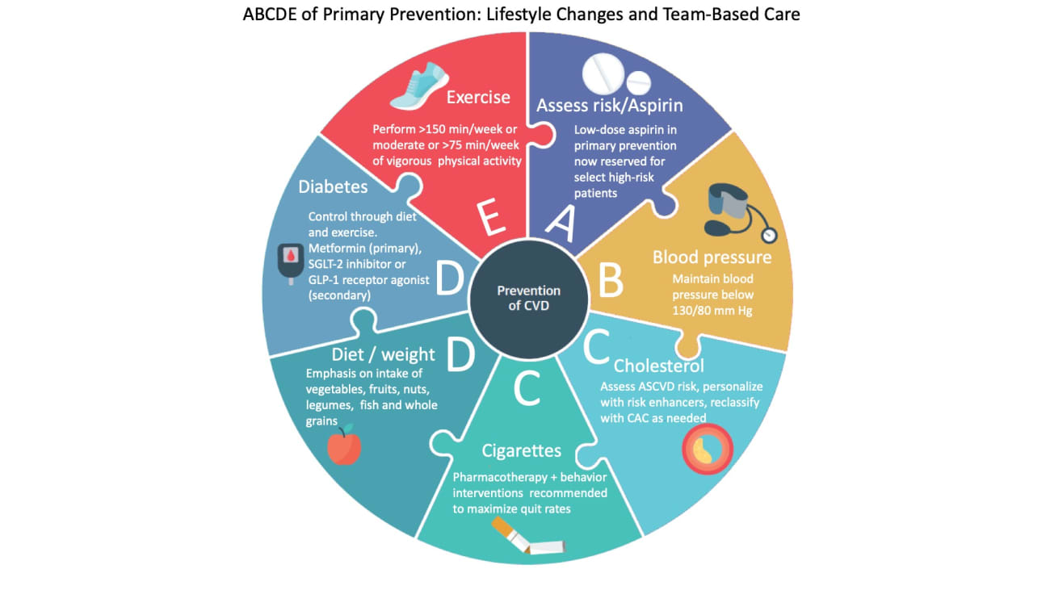

Slide 15
Functionality of program

Slide 16
GOALS OF THE PROGRAM
Access
  To provide access to top quality medications and medical services from the U.S to our families and friends back at home. No middleman and no counterfeit
Cost
  Very affordable and paid for by relatives living in the U.S
Peace of mind
  Knowing that your families and friends back at home are getting the right medical attention at the right time, improving drug adherence thus better quality of life

Slide 17
MEDICATION MANAGEMENT SERVICES
Access to medications
  Providing prescription medications to patients.
Consultation with the patient
  Going through patient medical history, labs, adherence initiatives and responding to any disease state questions.
Consultation with the provider
  Discussing patient cases with labs, treatment plan, disease state management goals, referrals, formulary alternatives and best evidence-based practices.

Slide 18
HOW IT WORKS
Visit https://gbpharmaceutical.com
  Services
  Diaspora Initiative
Fill out form with patient and sponsor information
  Name
  Address
  Contact info
  Payment form
We contact you within 24 hours to confirm the information and payment

Slide 19
HOW IT WORKS CONTINUES
Medication is processed and shipped within 7 days of request
Medication will be delivered and held at Grace Gardens Hospital in Ndop within 2 weeks of request**
  Patient notified by phone after arrival in Cameroon
  Patient will be notified upon arrival at Grace Gardens Hospital Ndop
Ideal for chronic medications, for all your acute needs please visit Grace Gardens Hospital, Ndop (see gracegardenshospital.com)
**timeframe prior to COVID-19 Pandemic

Slide 20
COST OF PROGRAM
Yearly registration of $20/patient
  Administrative management of patient records
  Six (6) months supply processed
  Yearly reports
Cost of drugs
  Will depend of drugs dispensed – rates similar to wholesale costs
Package deals**
  Consultation with patient – 1 free session, 15 mins block
  Consultation with provider – 1 free session, 15 mins block
**recommended 6-month labs and yearly physicals

Slide 21
Privacy with Data

Slide 22
PROTECTION
    We keep data safe using best practices
    Cutting edge technology, with security provided to protect patient data
    Access to patient records include
      Sponsor
      Patient
      Provider – with patient consent

Slide 23
REFERENCES
https://www.un.org/africarenewal/magazine/may-2013/counterfeit-drugs-raise-africa%E2%80%99s-temperature
https://pharma.nridigital.com/pharma_jan20/the_rise_of_fake_medicines_in_africa
https://www.cdc.gov/globalhealth/healthprotection/ncd/cardiovascular-diseases.html
https://www.cdc.gov/heartdisease/risk_factors.htm
https://www.who.int/bulletin/volumes/88/4/10-020410/en/
https://www.bbc.com/news/business-37470667

Slide 24
Questions??

